Slide 1
Nomad Program Overview

Slide 2
Overview
Full Motion Video
Imaging System
Gimbal
Data Output
Wide Area Camera
Cameras
Control Capability
Communications

Slide 3
Overview
Payload Comm Antenna
Mission Computer
Full Motion Video Gimbal
Bluefire Wide Area Camera System

Slide 4
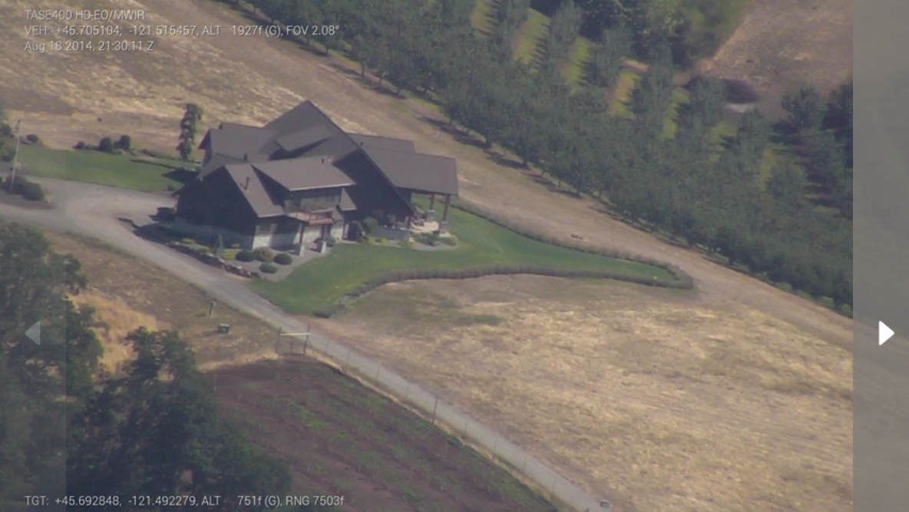
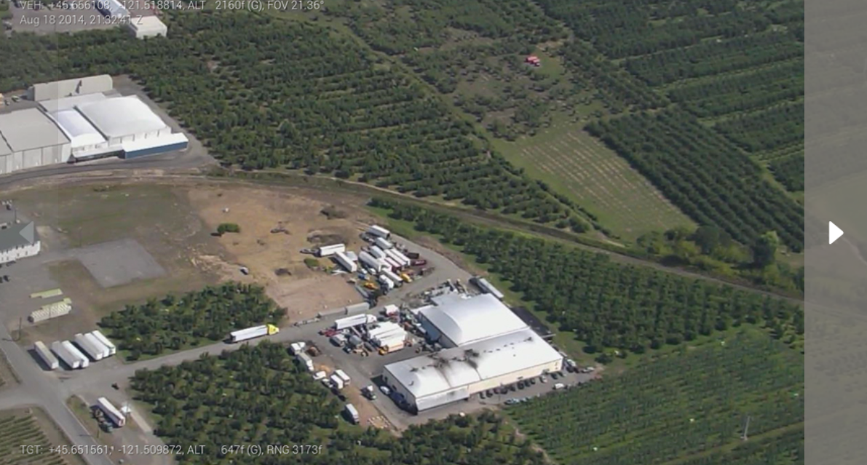
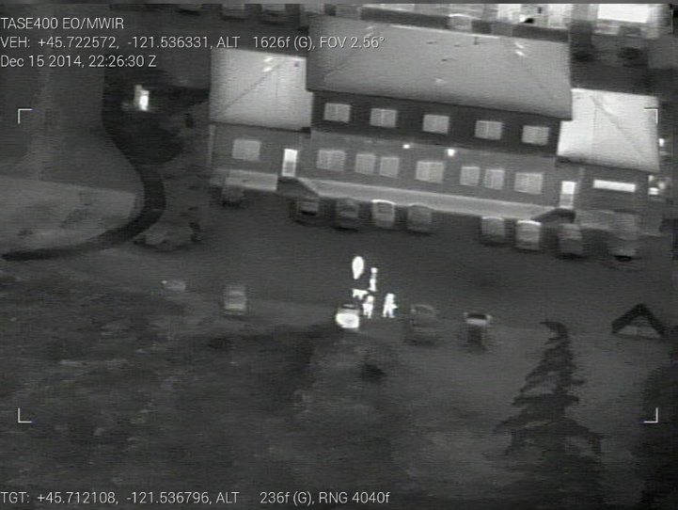
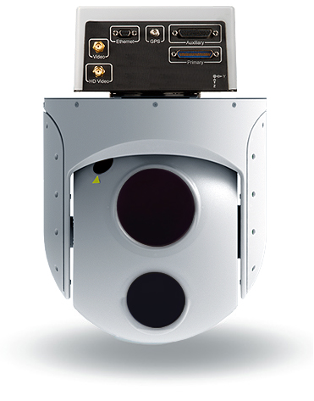
Full Motion Video
Size | 7 in dia
Weight | 9 lbs
Pointing Accuracy | 1.5 deg
Video Format | h.264
Video Metadata | MISB Compliant KLV Metadata
EO
GSD (200m Slant Range) | 0.10 m
GSD (1000m Slant Range) | 0.45 m
Frame Rate | 30 fps
MWIR
GSD (200m Slant Range) | 0.50 m
GSD (1000m Slant Range) | 0.80 m
Frame Rate | 28 fps
Training Note: This sensor was inspired by CloudCap TASE series sensors, but is completely notional for training.

Slide 5
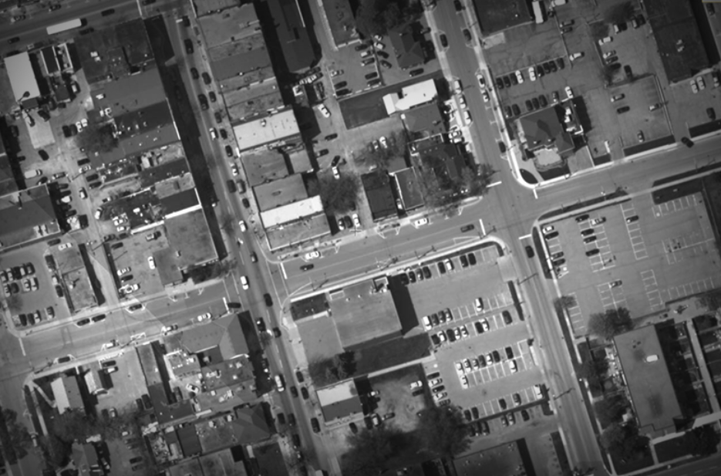
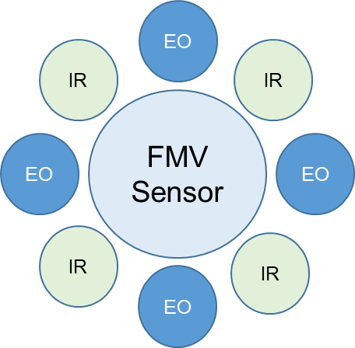
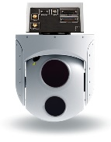
Bluefire Wide Area Camera
4 images are taken simultaneously and sent to the ground station, where they are stitched together into a single image
Weight | 12 lbs
Coverage Area (200 ft AGL) | 380,000 sq ft
Image Format | NITF Compliant JPEG 2000 Compressed
Video Metadata | MISB Compliant KLV Metadata
EO
GSD | 0.40 m
Latency | 1.25 seconds
Frame Rate | 3 fps
MWIR
GSD | 0.60 m
Latency | 2 seconds
Frame Rate | 1.5 fps
Can operate in either manual or automatic mode
User selectable day (electro-optic) or night (mid-wave IR)
Training Note: Image from Pixia website, https://www.pixia.com/solutions/hiper-stare/

Slide 6
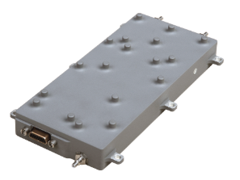
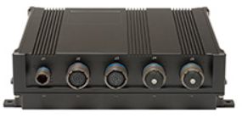
Mission Computer and Communications
Hardened Single Board Computer
Runs all mission processing applications
Health Monitoring
Product re-transmission
Increased Storage Capability
Capable of storing 1200 wide area images, or
120 minutes of video
Advanced lightweight tactical datalink
Capable of operating in Ku, L, S and C bands
Data rates up to 40 mb/s
Range up to 15 nautical miles
Weight | 1 lb
Processor | Quad Core Intel Processor
Storage | 1 TB Solid State
RAM | 8 GB
Training Note: Image from MPL website, https://www.mpl.ch/t2401.html/
Training Note: Image from L3 Website
https://www2.l3t.com/csw/products/airborne/bandit.htm

